Slide 1

Deep Learning Crash Course
Hui Xue
Fall 2021
www.deeplearningcrashcourse.org

Slide 2

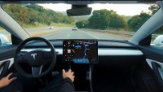
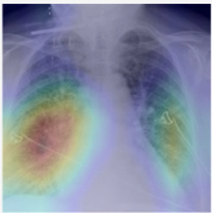
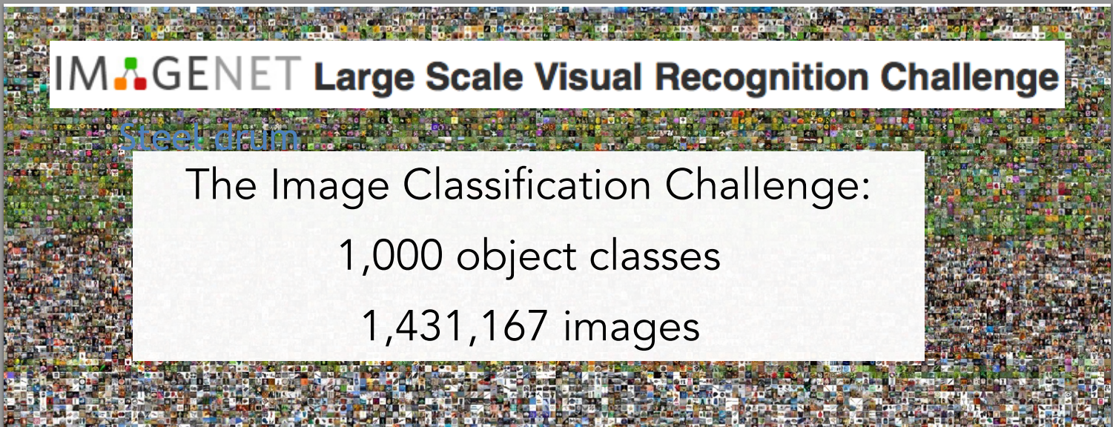
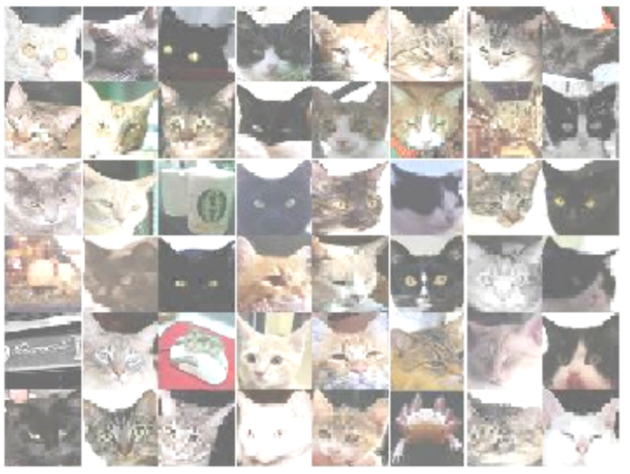
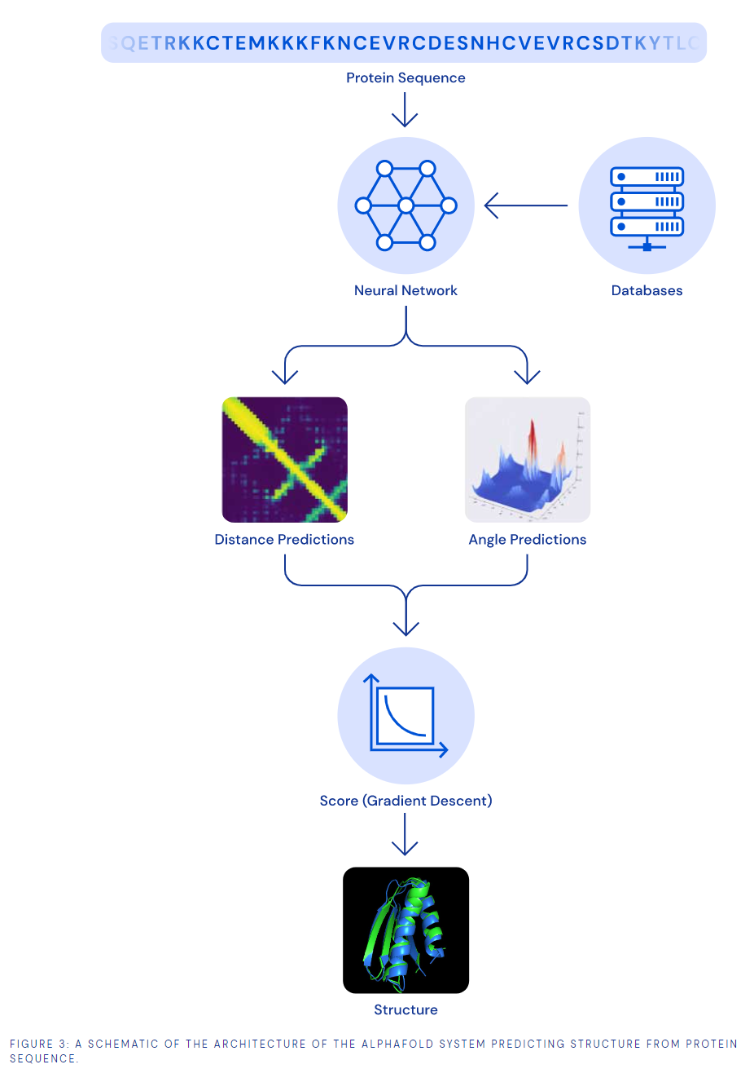
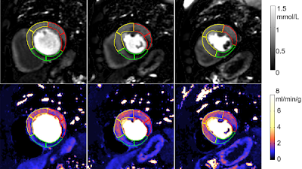
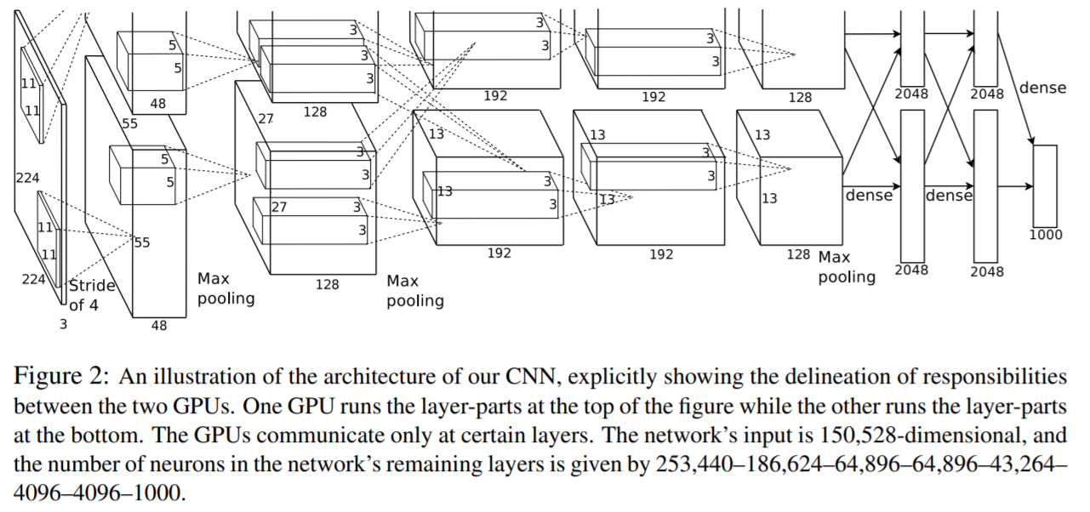
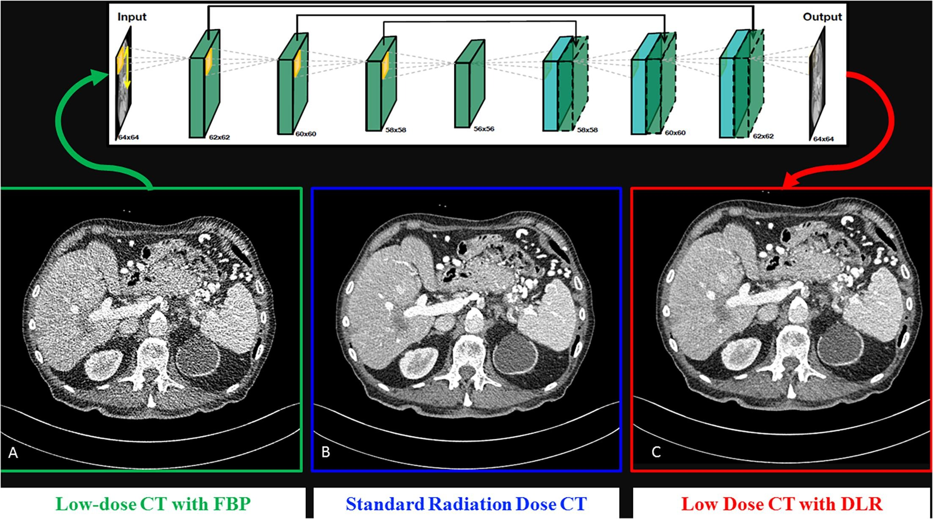
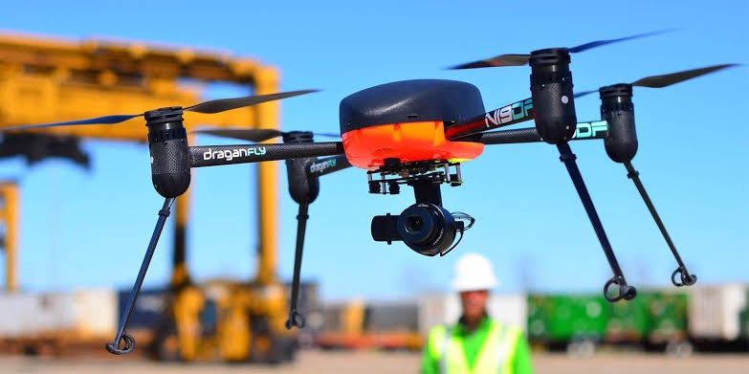
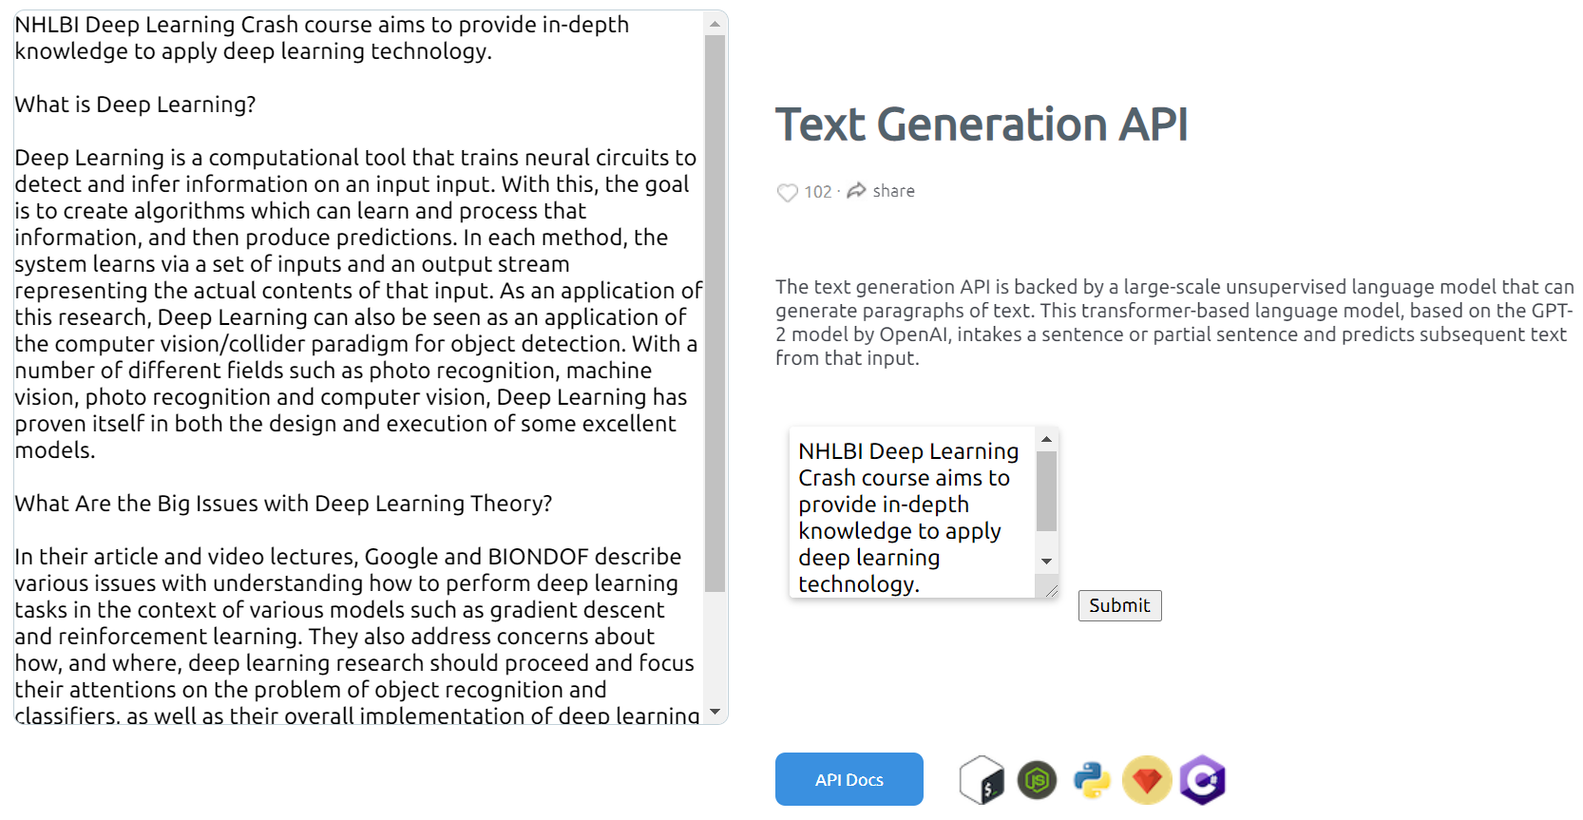
Deep Learning (DL) is making impact in many fields
https://www.youtube.com/watch?v=tlThdr3O5Qo
https://pubs.rsna.org/doi/10.1148/ryai.2021190228
https://pubs.rsna.org/doi/10.1148/ryai.2020200009
Alex net
Google Cat Study -
16000 computers to recognize cat. 2012.
https://deepmind.com/blog/article/AlphaFold-Using-AI-for-scientific-discovery
https://github.com/cs231n/cs231n.github.io
https://www.sciencedirect.com/science/article/pii/S1120179720302866?via%3Dihub
https://dl.acm.org/doi/10.1145/3065386
https://arxiv.org/abs/1112.6209
Deep Learning is one set of core technique which can serve many purposes …
https://medium.com/vsinghbisen/how-ai-based-drone-works-artificial-intelligence-drone-use-cases-7f3d44b8abe3
https://deepai.org/machine-learning-model/text-generator

Slide 3
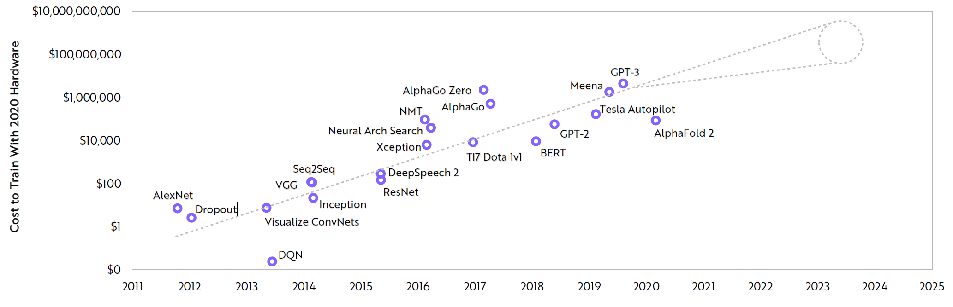
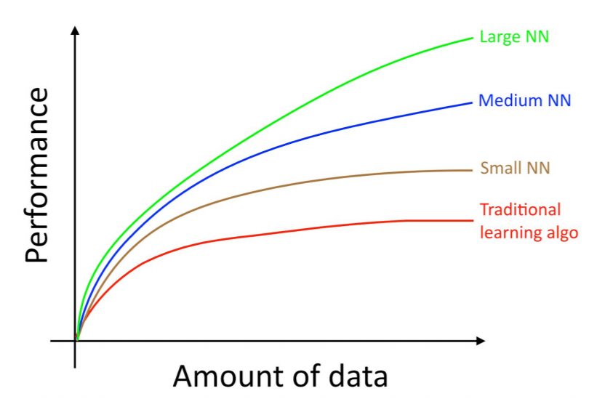
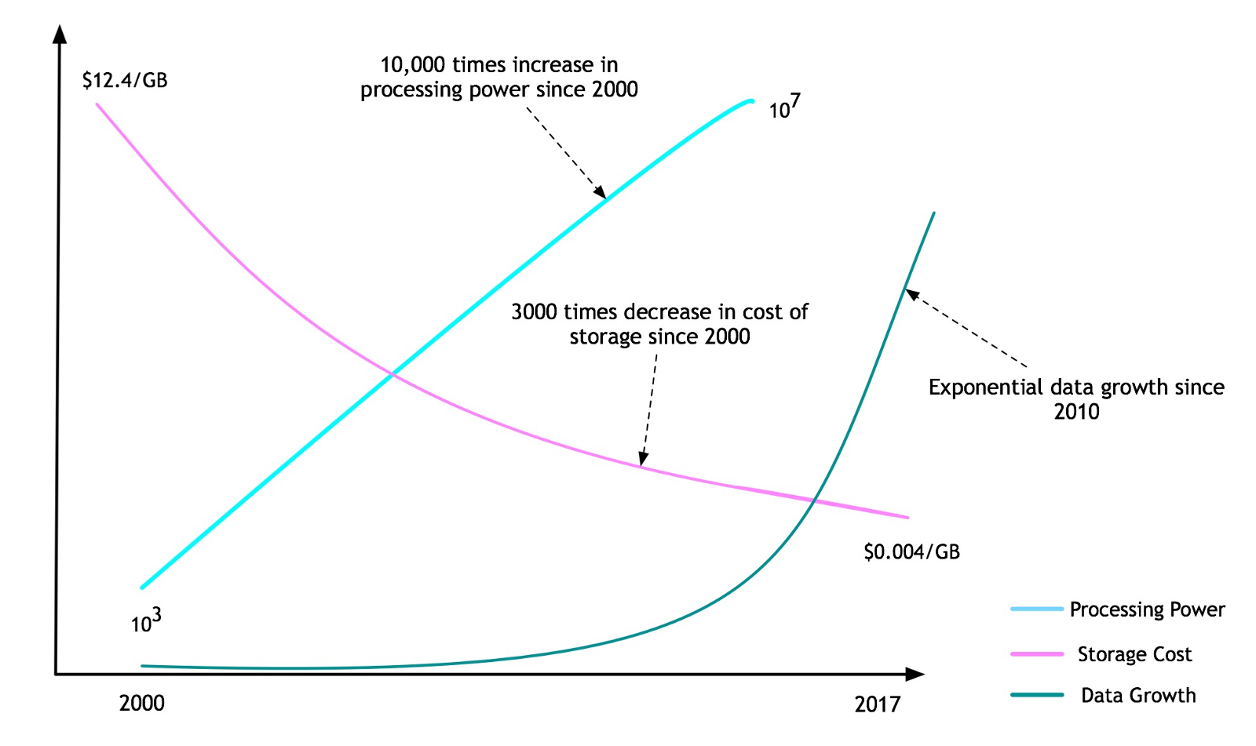
A combination of Data, Computing, Algorithm, Applications
So far, overall effect is still higher training cost
Model size increases ~10x per year + Data size increases
Computing power
Bigger/better model
Why deep model is inevitable
Data
Machine Learning Yearning,

Slide 4
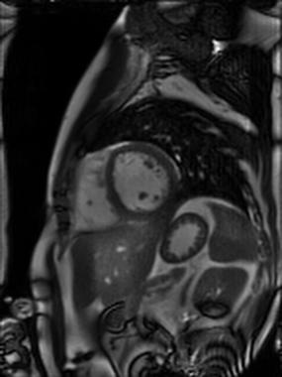
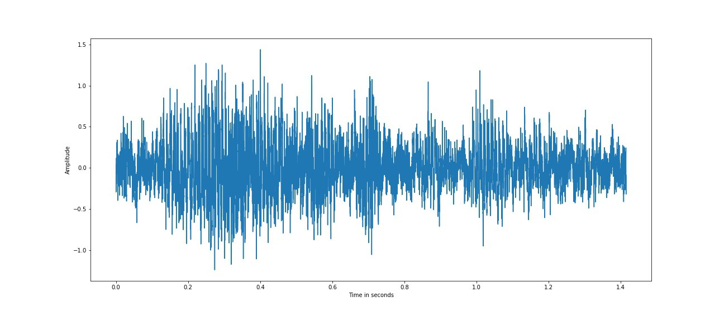
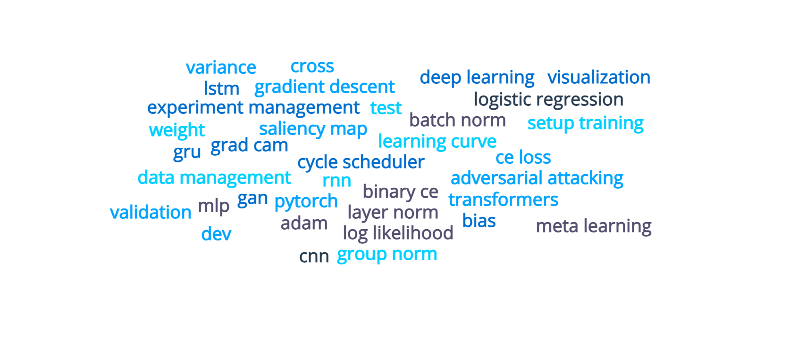
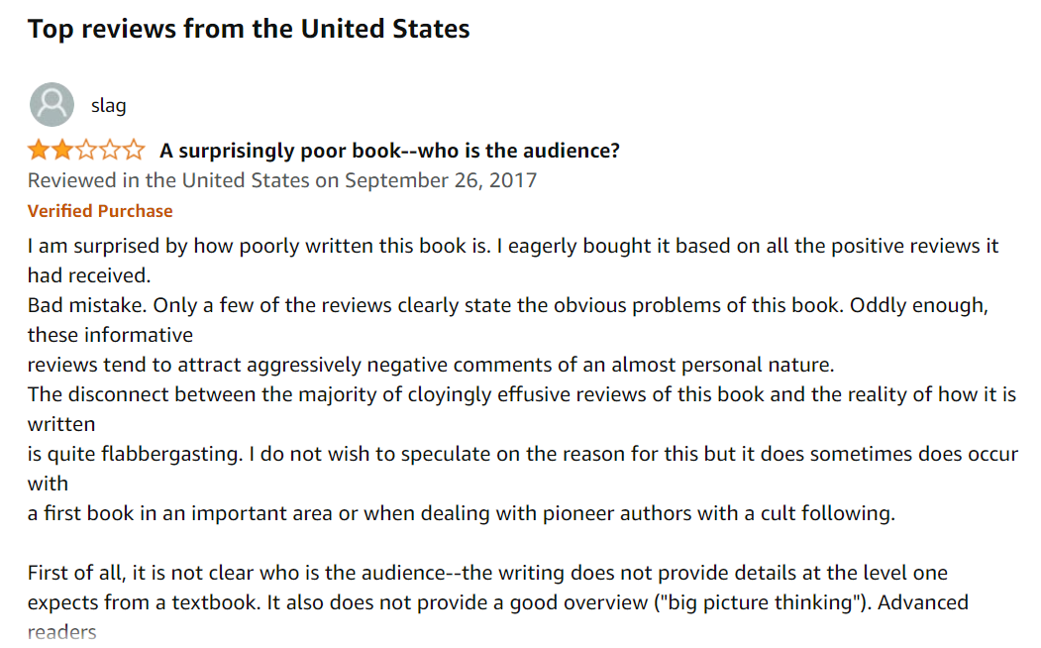
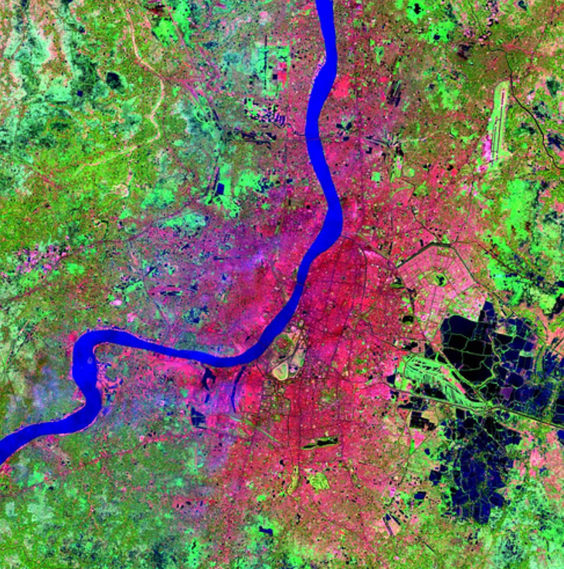
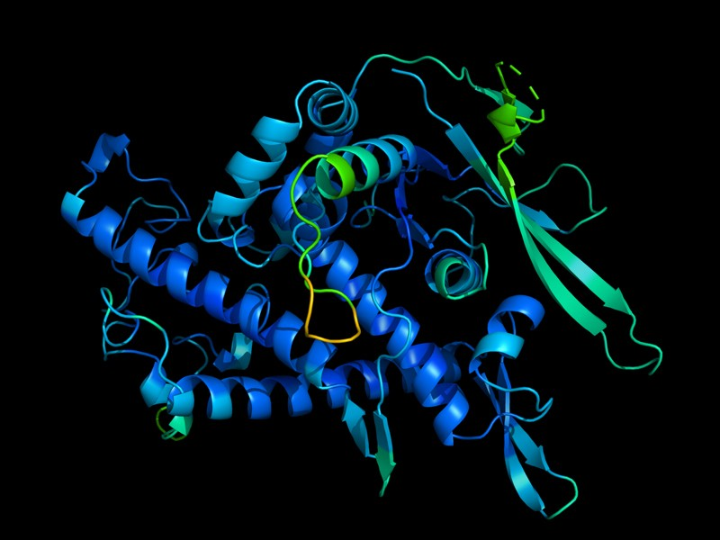
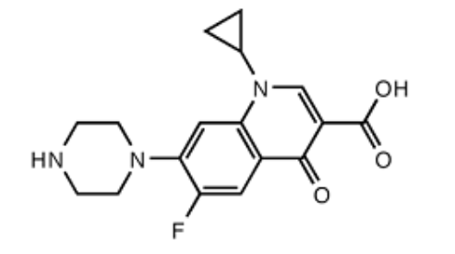
Why to learn DL: same technology, widely applicable
Automation
AI assistant
Prediction
High duration system with 0% down time
Super-human performance in some applications
… still rapidly developing
Deep learning toolbox
https://www.nature.com/articles/d41586-020-03348-4
https://towardsdatascience.com/review-deep-learning-in-drug-discovery-f4c89e3321e1

Slide 5
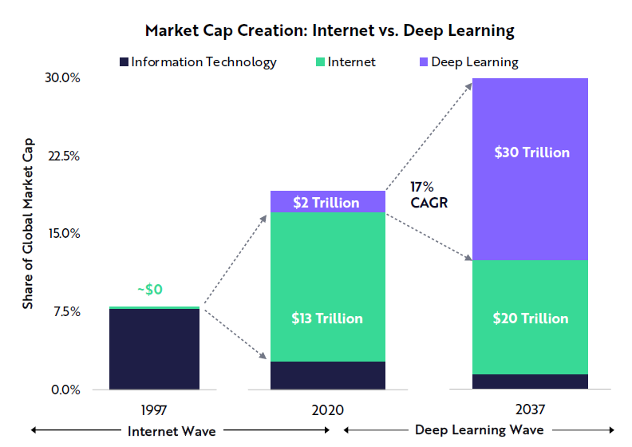
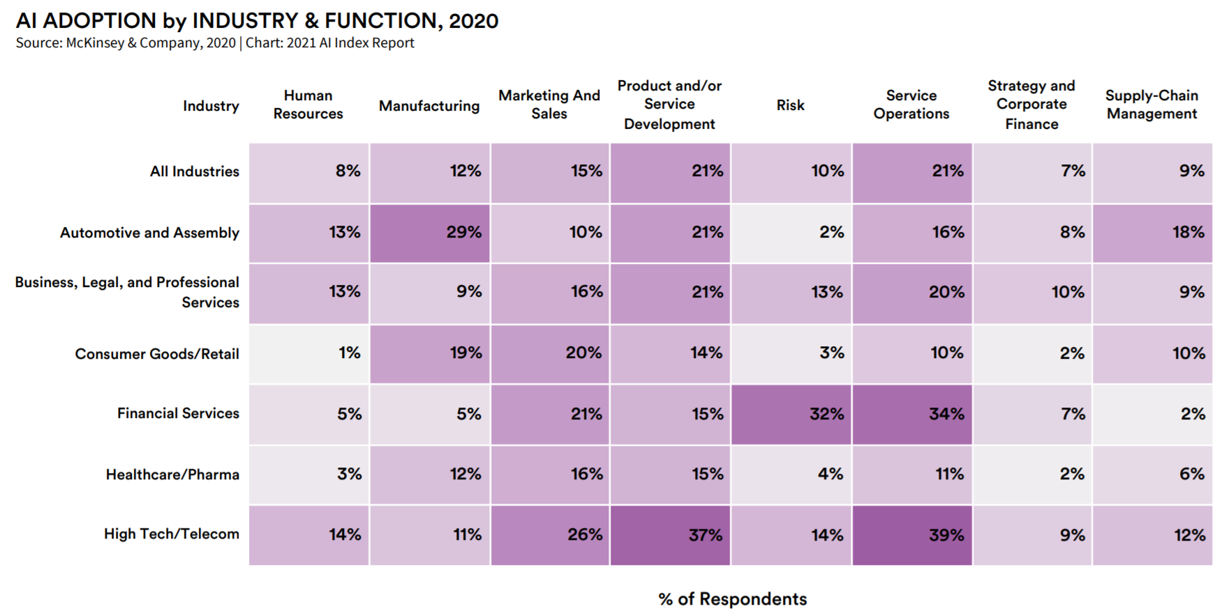
Big future with a long-way to go
According to ARK's research, deep learning will add $30 trillion to the global equity market capitalization during the next 15-20 years.t
-- Big Idea 2021, https://ark-invest.com/big-ideas-2021/
https://aiindex.stanford.edu/wp-content/uploads/2021/03/2021-AI-Index-Report_Master.pdf
Adoption of DL has a long-way to go and requires innovation.

Slide 6
What we want to achieve
Introduce the basics of deep learning
Present in-depth how DL model works
Provide practices to build your own model
Grow interest and improve community awareness
Prepare trainees and fellows for DL related jobs
👏After this course and assignments, start to apply DL to your field …

Slide 7
For 2021 Fall offering
Course logistics

Slide 8


Information and Course Resources
Website – www.deeplearningcrashcourse.org
Discussion – Slack channels
Assignment – Gradescope, you should receive invitation already!
Office hours – Announced on course website
Course instructors:
Hui Xue (hui.xue@nih.gov)
David Hansen (davidchansen@gradientsoftware.net)

Slide 9
Assignments
Website – www.deeplearningcrashcourse.org/nhlbi2021
Has information for Setup
Tech review session as we go
Datasets are for NHLBI only
Require to know python programming
We will demo some basics and how to debug the code
GPU resources
Good news! If you need a GPU computer, we will provide ab Azure VM with 1K80 GPU
Email hui.xue@nih.gov

